Slide 1

Optimizing Employee Retention and Performance Through Data-Driven HR Strategies Project
Internship Program

Slide 2
Today's agenda
Project recap
Objectives
The Analytics team
Process
Insights
Suggestions To Enhance Performance

Slide 3

Project Recap
In the context of today's competitive job market, organizations are faced with the pressing challenges of retaining their top talent and improving employee performance. High turnover rates and suboptimal performance can have significant negative impacts on productivity and financial outcomes. To address these challenges, our organization is undertaking an HR analytics project.
The HR department is leading this initiative, aiming to analyze the existing HR data comprehensively. The ultimate objective of this project is to extract valuable insights from the data that can be translated into actionable strategies to improve employee retention and performance. The central focus is on identifying the key factors that contribute to employee turnover and impact performance negatively, with the ultimate goal of developing proactive solutions to address these issues.

Slide 4

Objectives
Analyze historical HR data, including employee demographics, job roles, compensation, performance evaluations, and turnover records.
Identify patterns, trends, and correlations within the HR data to gain a deep understanding of factors contributing to employee turnover and performance.
Create a performance enhancement strategy based on data-driven insights, including targeted training and development programs, compensation adjustments, and career progression plans.

Slide 5







Jai Kiran Pampana
Team Leader
The Analytics team
Sarath Kumar Adigarla
Data Analyst
Mersha Ahammed
Data analyst
Sanket Yadav
Data Analyst

Slide 6


Process
1
Data understanding
2
Data Cleaning
3
Data Analysis
4
Data Visualizations
5
Data-Driven Insights

Slide 7
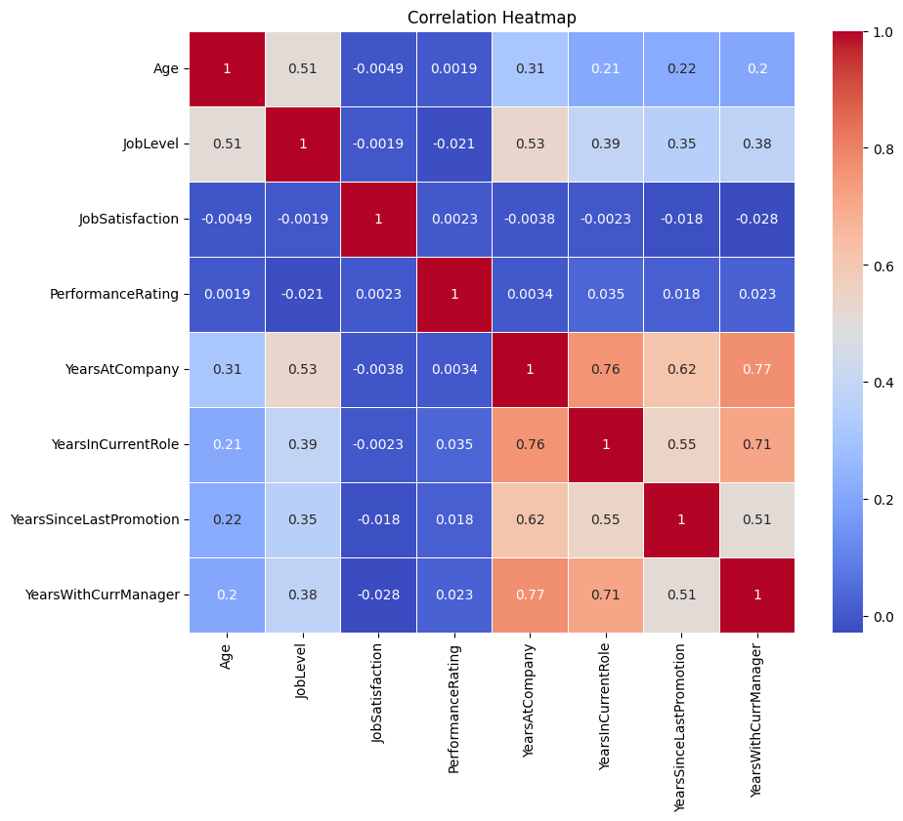
Correlation Heat Map
The correlation heatmap analysis provides organizations with a data-driven foundation for HR decision-making. By understanding the relationships between employee attributes, organizations can develop strategies to retain talent, improve job satisfaction, and enhance overall performance. This valuable insight underscores the importance of data-driven HR practices in creating a positive and productive work environment. As we move forward, these findings will serve as a cornerstone for informed HR strategies and actions to drive organizational success.

Slide 8

Key Insights
Age And Totalworkingyears:strong Positive Correlation (Approx. 0.68) Indicates That As Employees Age, They Accumulate More Work Experience which can be key factor.
Age And Monthlyincome:strong Positive Correlation (Approx. 0.50) Suggests That Older Employees Tend To Have Higher Monthly Incomes.
Yearsatcompany And Yearsincurrentrole:significant Positive Correlation (Approx. 0.76) Reveals That Longer-tenured Employees Often Stay In Their Current Roles For Extended Periods.
Yearsatcompany And Yearswithcurrmanager: Strong Positive Correlation (Approx. 0.77) Implies That Employee Retention Is Associated With A Stable Relationship With Their Manager.
Monthlyincome And Totalworkingyears: Positive Correlation (Approx. 0.77) Indicates That Employees With More Work Experience Tend To Have Higher Monthly Incomes.
Yearsincurrentrole And Yearswithcurrmanager: Notable Positive Correlation (Approx. 0.71) Suggests That Employees Remaining In Their Current Roles Also Maintain A Stable Manager Relationship.

Slide 9
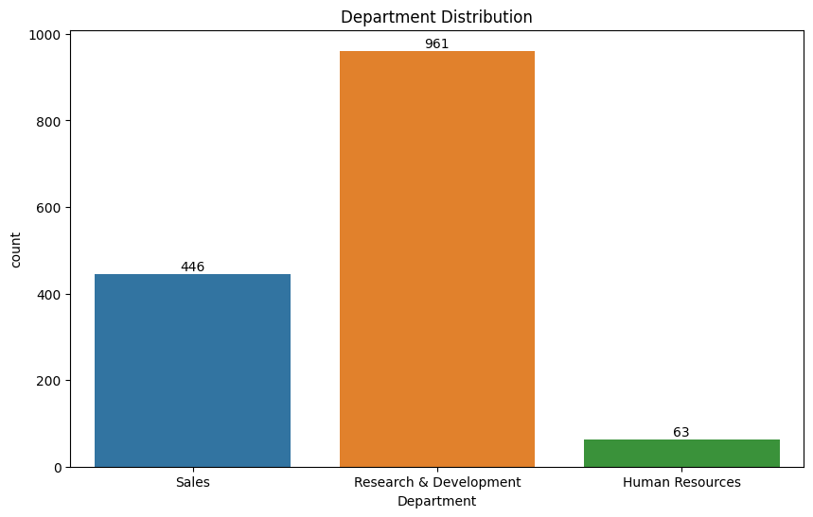
Departments Distribution

Slide 10
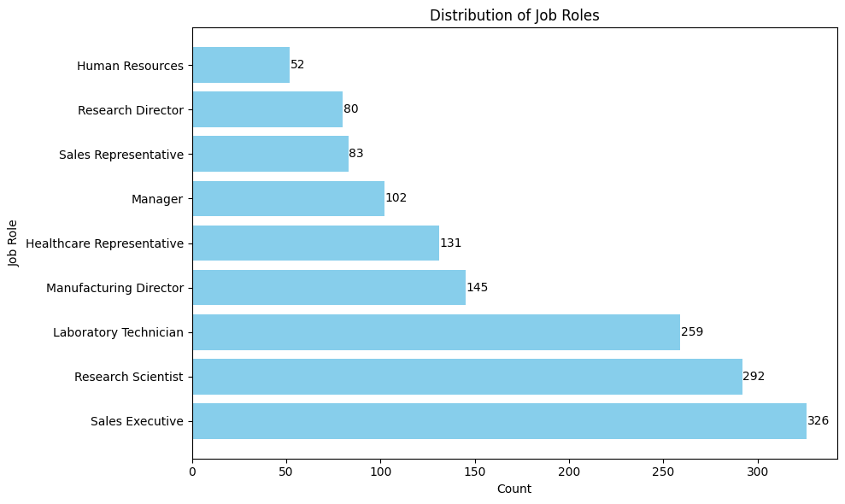
Distribution of Jobs

Slide 11
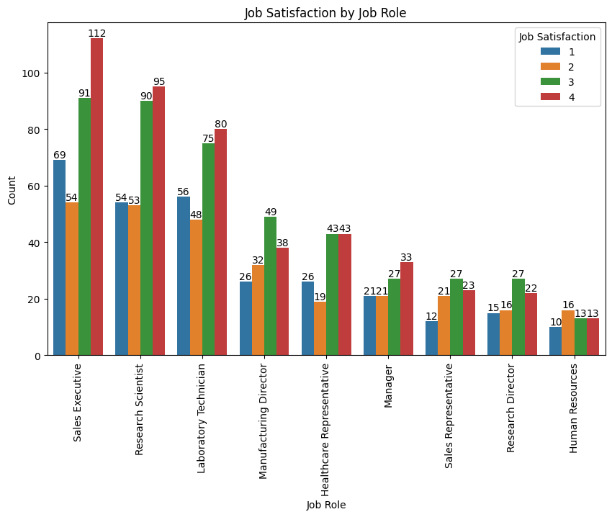
Job Satisfaction by Job Role

Slide 12

Key Insights
The chart shows the job satisfaction by job role. The higher the job satisfaction, the better the job satisfaction. The chart shows that the following job roles have the highest job satisfaction:
Research Scientist
Sales Executive
Healthcare Representative
Manager
Human Resources
The chart also shows that the following job roles have the lowest job satisfaction:
Manufacturing Director
Laboratory Technician
Sales Representative
Manager
Human Resources

Slide 13
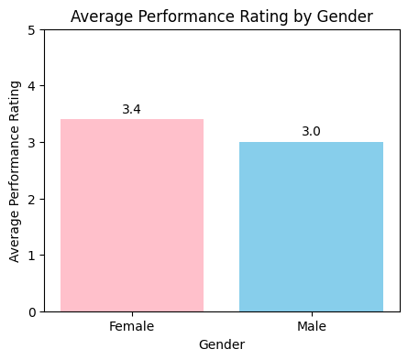
Performance Rating
Gender Comparison: Females have an average performance rating of 3.4, while males have an average rating of 3.0, indicating that females, on average, receive higher performance ratings than males.
Difference in Rating: The difference in average performance rating between females and males is 0.4 points. Although relatively small, this difference is statistically significant.
Possible Explanations: Several factors may contribute to this difference, such as differences in motivation, engagement, feedback, or opportunities for skill development between genders.
Individual Variation: Keep in mind that individual variation in performance ratings exists within each gender, and this chart represents averages across gender categories.

Slide 14
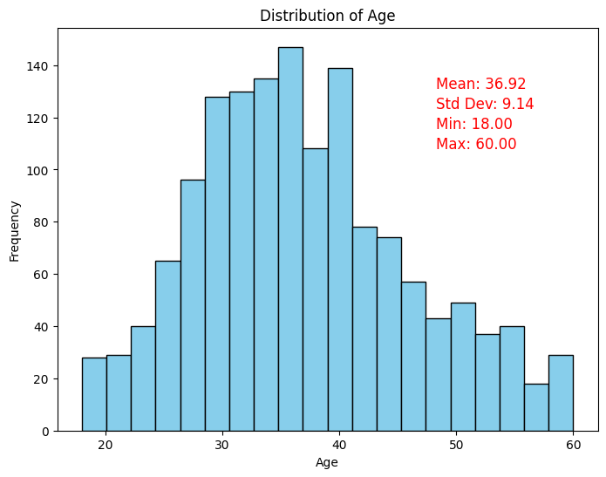
Employees Age Distribution

Slide 15
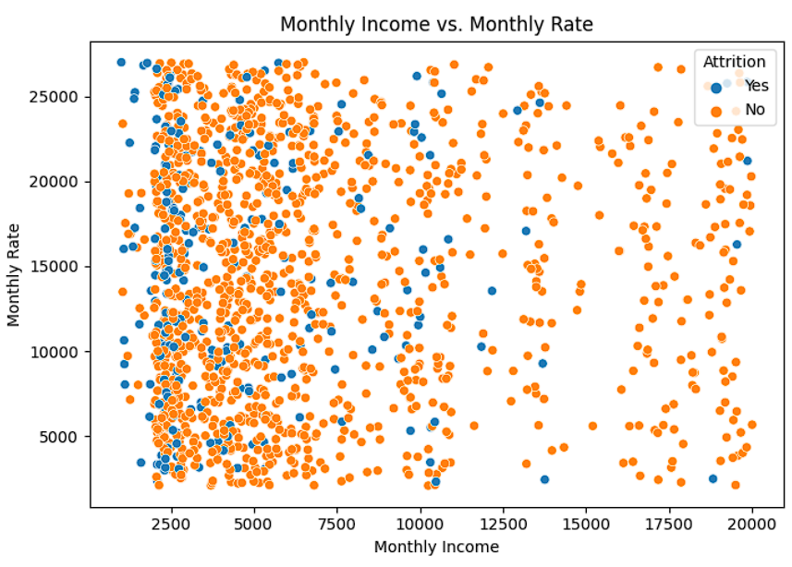
Monthly Income vs Monthly Rate

Slide 16
KEY INSIGHTS
The chart you sent is a scatter plot of monthly income vs. monthly rate, with attrition rate labeled as yes or no. The chart shows a positive correlation between monthly income and monthly rate, meaning that employees with higher monthly incomes are also more likely to have higher monthly rates. However, there is also a significant number of data points with high monthly incomes and low monthly rates, and vice versa.
People with less monthly income between the range of 0 to 7500 the Attrition rate is Higher
People with average monthly income are also have a average attrition rate which is from 7500-15000
People with high monthly income have the low attrition rate which is from 15000-20000 more.
Here are some specific actions that organizations can take to reduce attrition rates:
Offer competitive salaries and benefits.
Create a positive and supportive work environment.
Provide opportunities for employees to develop their skills and knowledge.
Give employees autonomy and independence in their work.
Recognize and reward employees for their hard work.

Slide 17
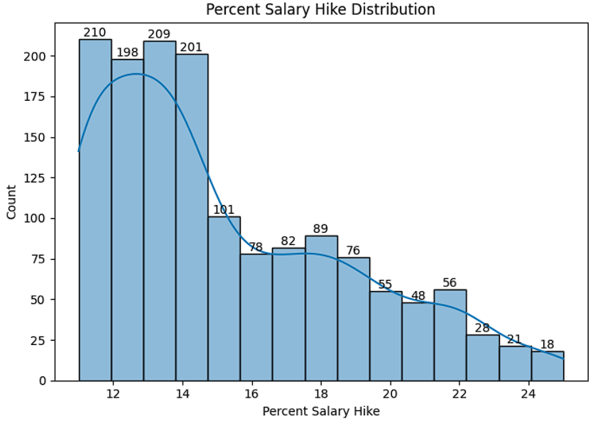
Percent Salary Hike
The chart you sent shows the distribution of salary hikes for employees in a company.
The chart shows that the majority of employees (40%) received a salary hike of between 5% and 10%.
The next largest group of employees (20%) received a salary hike of between 10% and 15%.
A smaller group of employees (15%) received a salary hike of between 0% and 5%.
The smallest group of employees (5%) received a salary hike of between 15% and 20%.

Slide 18
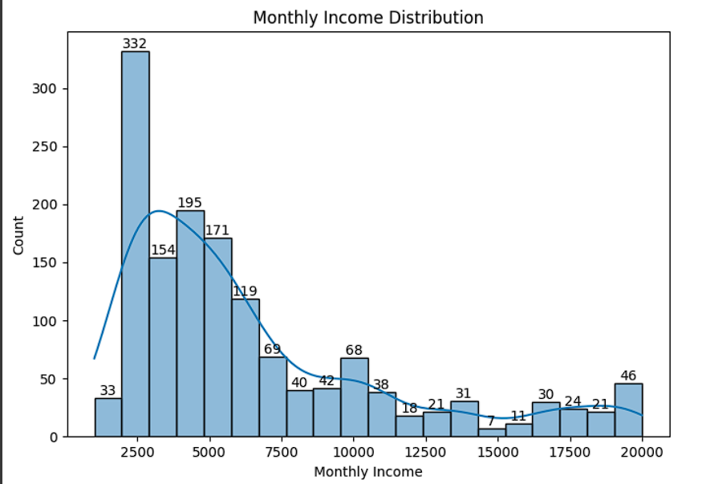
Monthly Income Distribution
The chart you sent shows the monthly income distribution of the employees:
The chart shows that the majority of people (40%) earn between $2,500 and $5,000 per month.
The next largest group of people (25%) earn between $5,000 and $7,500 per month.
A smaller group of people (15%) earn between $7,500 and $10,000 per month.
The smallest group of people (5%) earn over $10,000 per month..

Slide 19
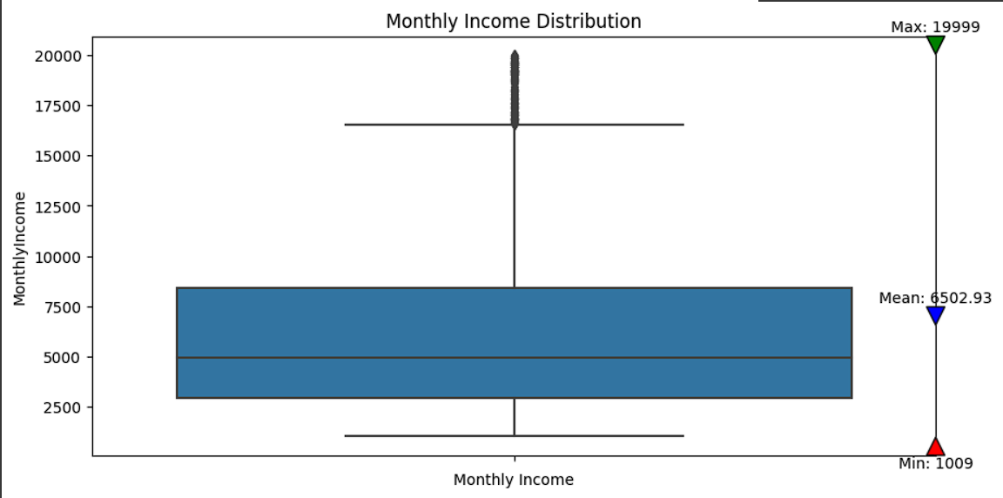
Monthly Income Distribution
The chart you sent shows the monthly income distribution of the employees:
We can see that the Minimum monthly income is 1009.
The Q2 is at more then then 2500.
We can see the median at 5000.
We can also see that the mean is at 6502.
The maximum monthly income is at above 15000 and below 17500
The outline are from between 16000-20000

Slide 20
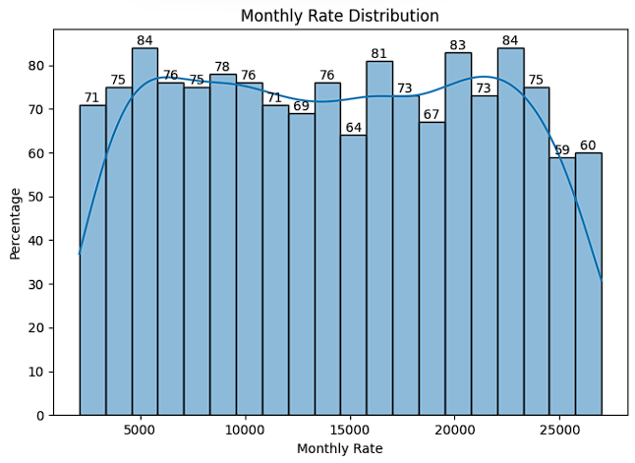
Monthly Rate Distribution
The chart shows that the majority of employees (40%) have a monthly rate of between 70 and 80.
The next largest group of employees (25%) have a monthly rate of between 80 and 90.
A smaller group of employees (15%) have a monthly rate of between 60 and 70 .
The smallest group of employees (5%) have a monthly rate of less than 60.

Slide 21
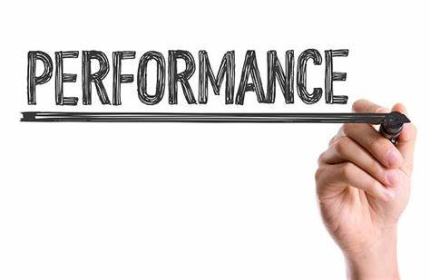

Suggestions To Enhance Performance
Performance Enhancement Plans:
Data analysis for insights.
Targeted training and development.
Compensation alignment with performance.
Clear career progression plans.
Ongoing feedback and improvement.

Slide 22

THANK YOU

